Slide 1
India covid-19 analysis
By: Srivathsav Mitnala

Slide 2
Data extraction
The data used in this analysis was extracted using an api link
The data was initially in json format
The required features were then extracted from this json structure and then it was written into different csv files

Slide 3
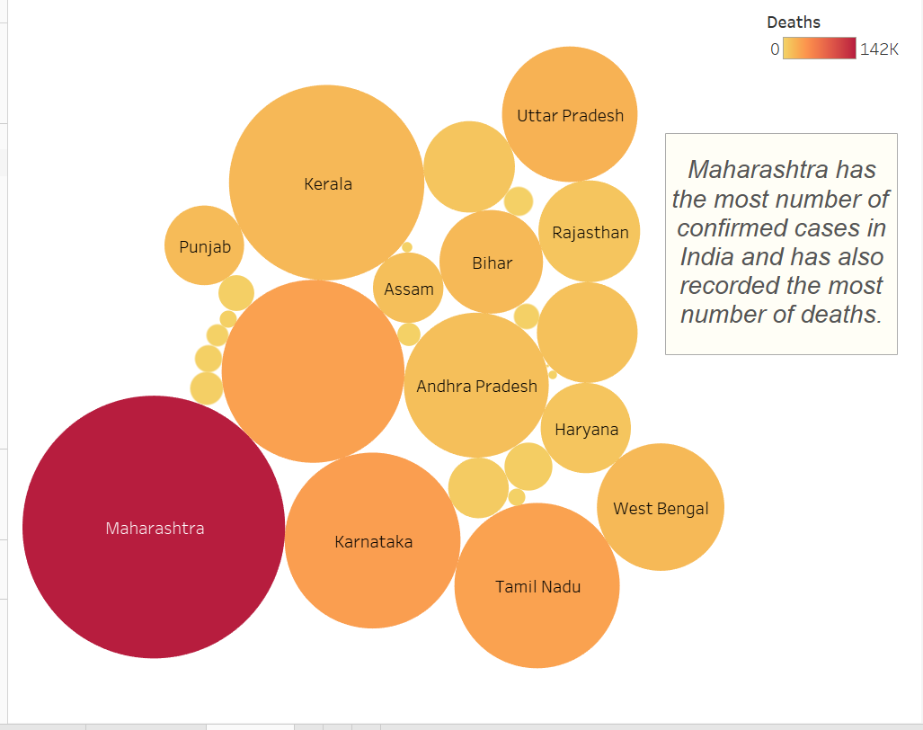

Slide 4
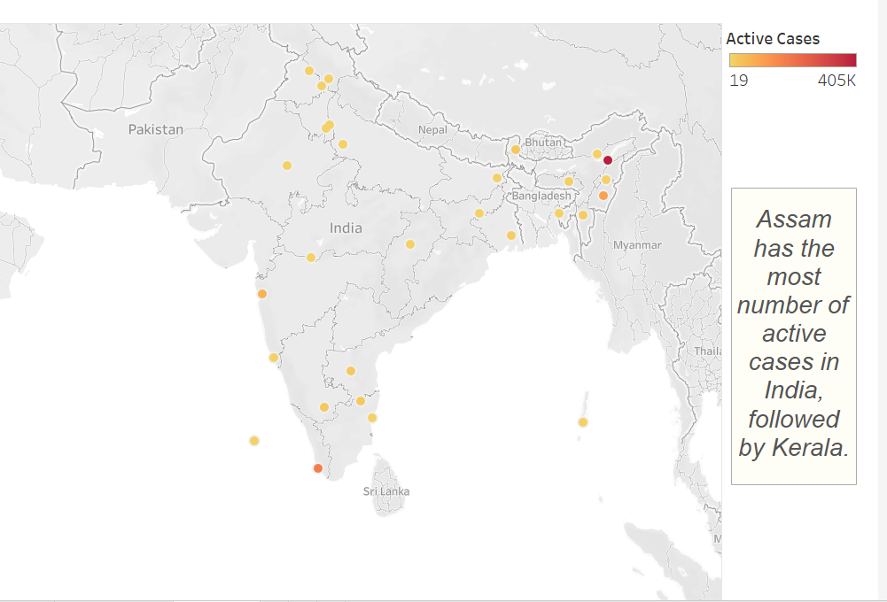

Slide 5
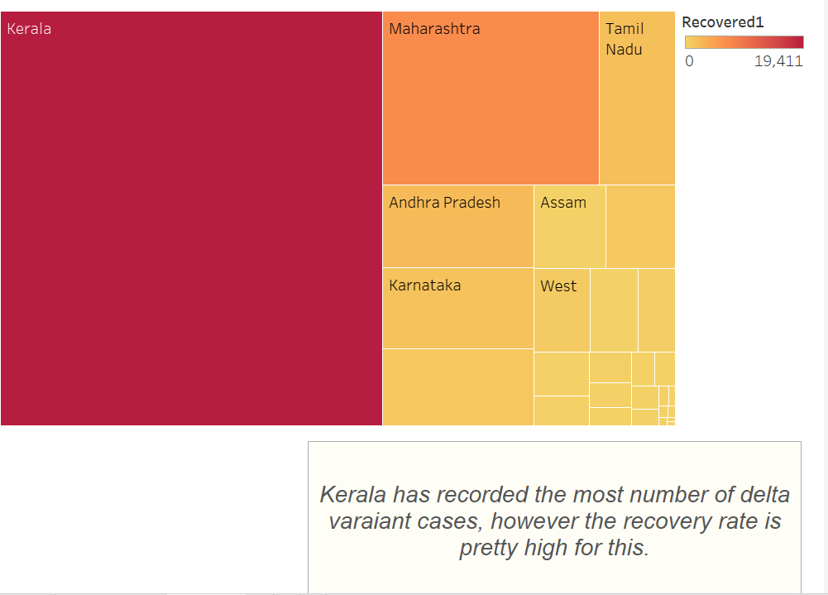

Slide 6
Conclusions
Although there is a decrease in number of active cases compared to before, it is necessary that the required safety protocols still need to be followed, as there is a chance that the delta variant spreading at a faster rate especially in the smaller states
The recovery rate for delta variant is pretty high as can be seen in the data for all the states, which is a positive going forward

